Slide 1
AWS
Day 1 Session 2

Slide 2
Objectives
AWS account basics
AWS free tier account
Create an AWS account
How to Navigate AWS console
Identity Access Management
What is IAM ?
IAM initial setup and Configuration
IAM user and policies
IAM roles

Slide 3
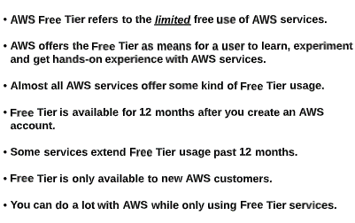
AWS account basics
First we will understand AWS free tier account.

Slide 4
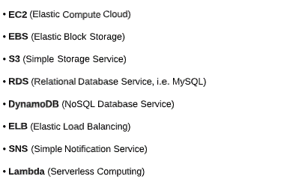
AWS account basics
First we will understand AWS free tier account.
Commonly used and popular services offers in free tier account are
For more info: Free Cloud Computing Services - AWS Free Tier (amazon.com)

Slide 5
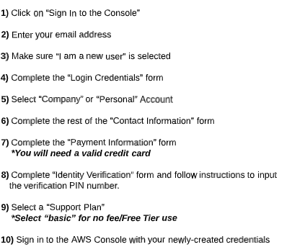
Create AWS account
In order to create AWS free tier account visit: https://portal.aws.amazon.com/billing/signup#/start/email
and follow given below steps.

Slide 6
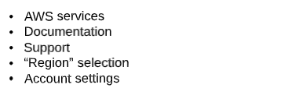
AWS Console tour
Once account will be created then we can login to our AWS account and navigate in AWS console.
We will explore

Slide 7
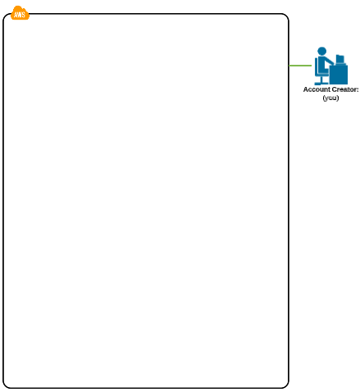
Identity Access Management
So far we have created an AWS account so, along with our account we will be root user. (Account Owner).
Now, next step is, We will have to create IAM users.
Here comes the question, What IAM user is?

Slide 8
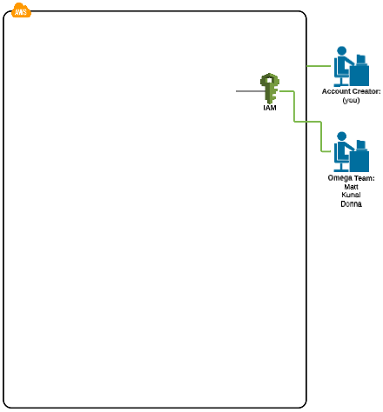
Identity Access Management
What is IAM user?
As you have created account, so you will become a root user but let’s consider that you are owner and you have to set up a team which will work with you and you have to give them access to your cloud.
So, IAM user are nothing but users who will be having access to our cloud by providing some credentials Which you as owner will provide to them.

Slide 9
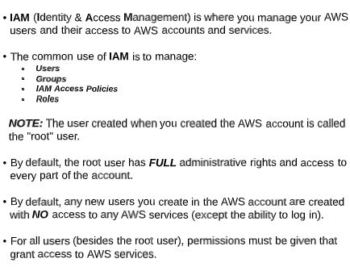
Identity Access Management
What is IAM user?

Slide 10
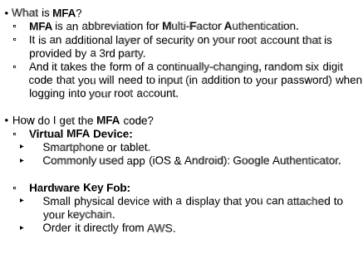
IAM
Once our root user will be created then as a best practice we hae to activate MFA.
What is MFA?

Slide 11
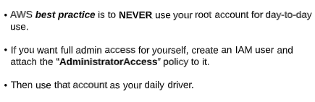

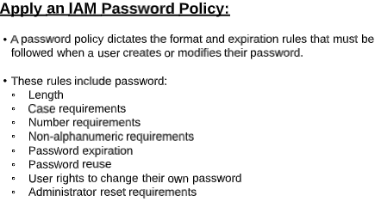
IAM

Slide 12
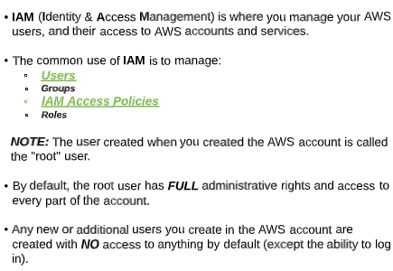
IAM
Let’s understand IAM user and access to AWS services.

Slide 13
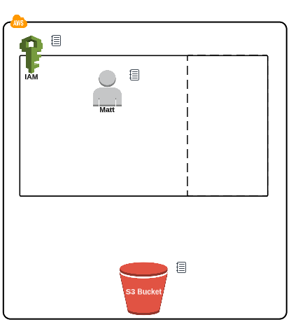
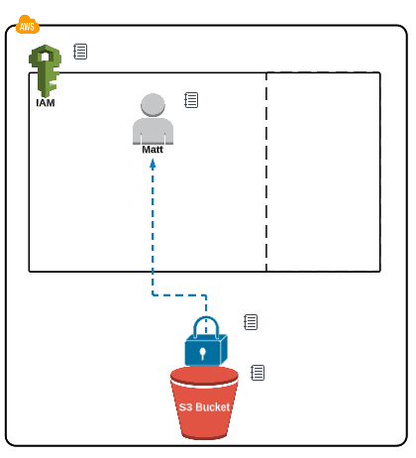
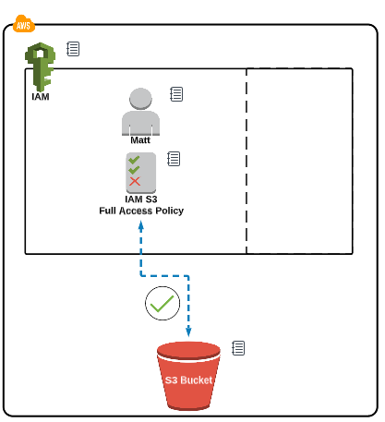
IAM
Let’s understand IAM user and access to AWS services.

Slide 14
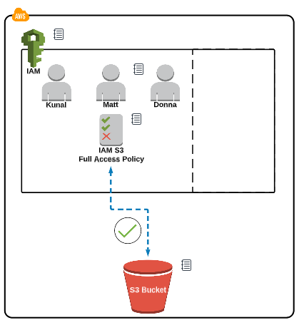
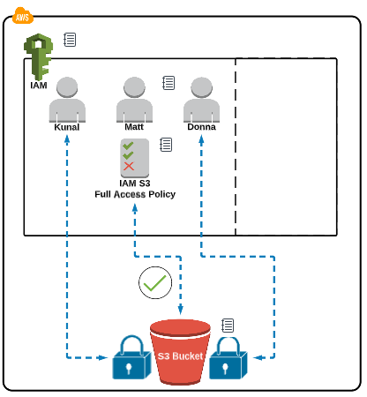
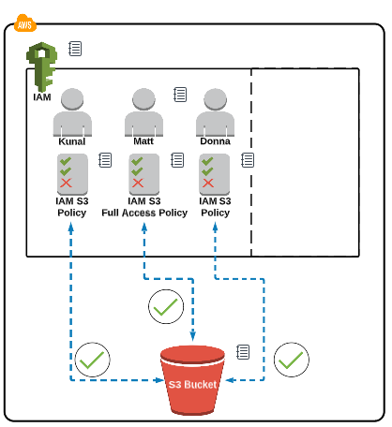
IAM

Slide 15
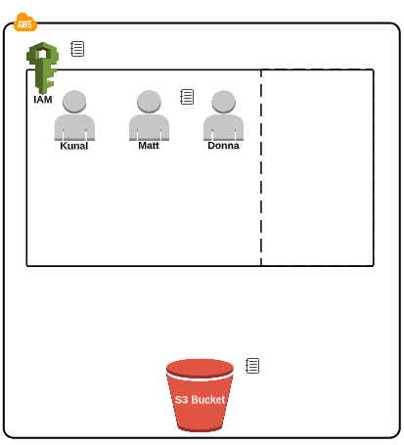
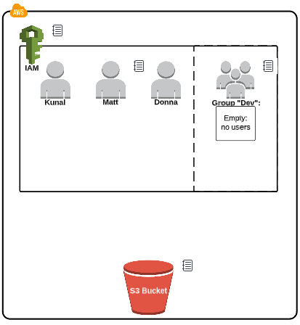
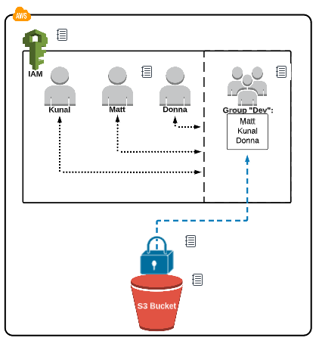
IAM
So, recently we have seen how to create users and provide them access but here we have created 3 users and given them access. Instead of this we can follow another approach that is create a group, add all user to this group and then provide access to group so all users in respective group can access the service.

Slide 16
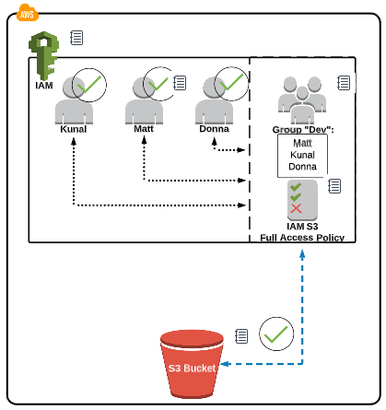
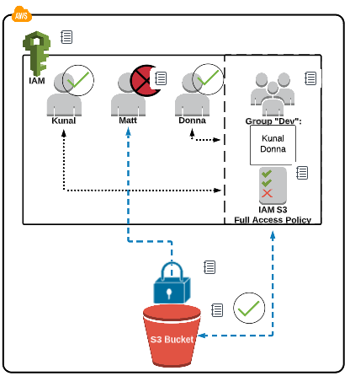
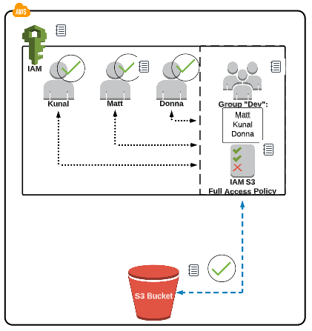
IAM

Slide 17
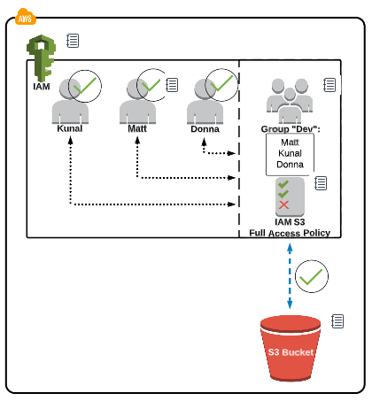
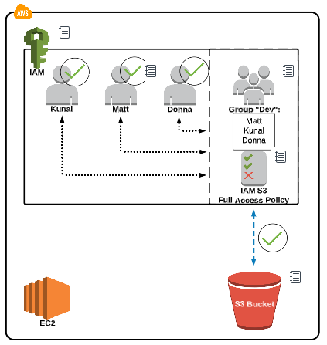
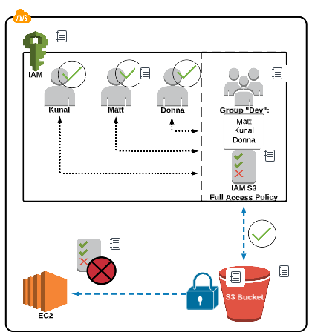
IAM role
In simple words, role is nothing but a kind of access to one AWS service to access another AWS service like a group.

Slide 18
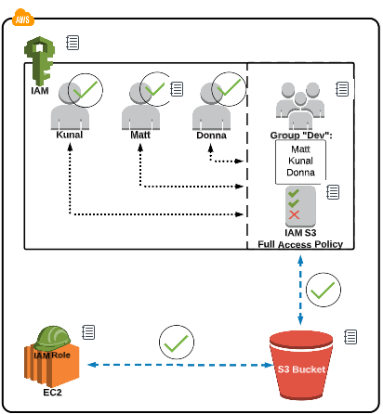
IAM role
So, here in order to let AWS EC2 communicate with S3 instance we will have to create a role.

Slide 19
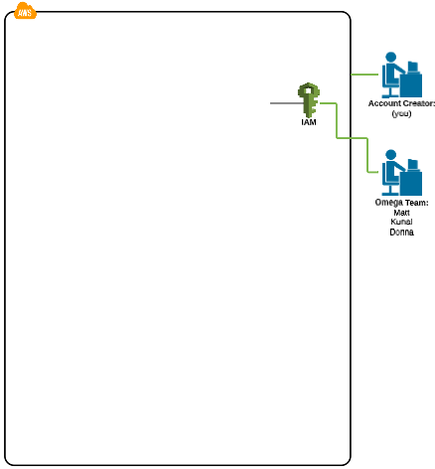
AWS IAM service
So far we have covered
Root user
IAM user
Creating user
Authentication
Providing access to user
Create group
Apply policies to group
Create role.
Now, we have completed the first service of AWS that is IAM

Slide 20
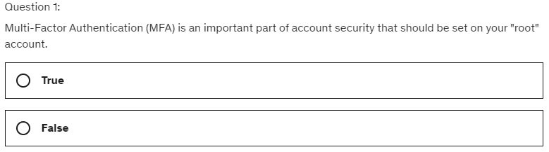
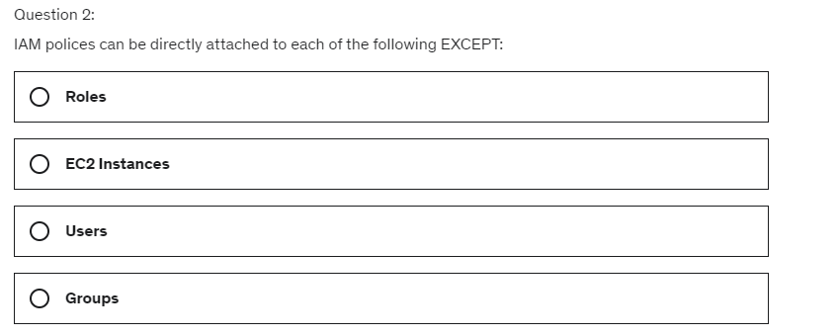
AWS IAM MCQ Questions

Slide 21
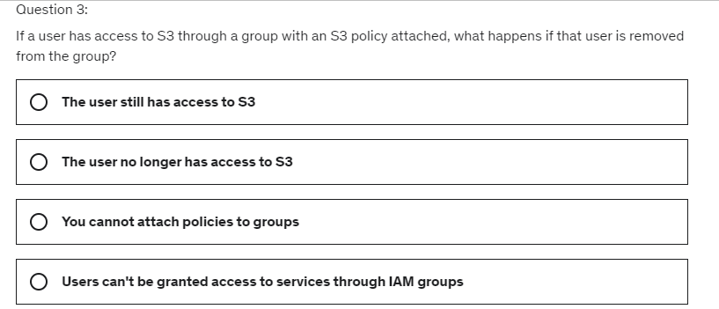
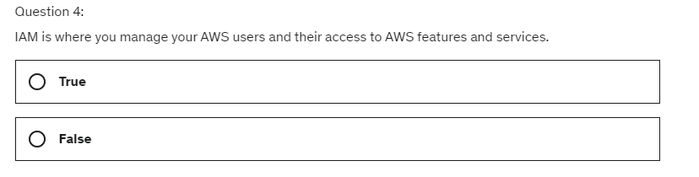
AWS IAM MCQ Questions

Slide 22
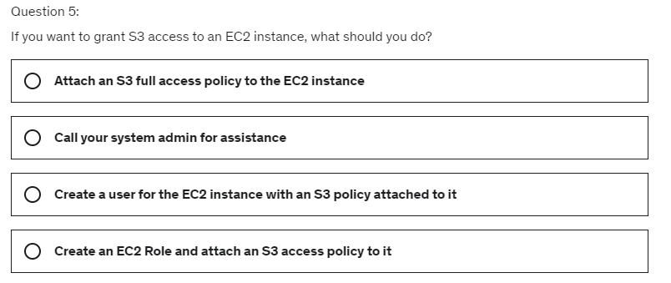
AWS IAM MCQ Questions

